Slide 1

SARDAR VALLABHBHAI PATEL INSTITUTE OF TECHNOLOGY, VASAD
INFORMATION TECHNOLOGY DEPARTMENT

Slide 2
SUBJECT:-Engineering Economics and Management
CODE:- 2130004
NAME:- DHARTI PARMAR
I.D.NO:- 217BEITG018
CLASS:- IT -1
YEAR :- SY

Slide 3

GREEN MARKETING

Slide 4
A SIMPLE DEFINATION
Green marketing refers to the process of selling products and/or services based on their environmental benefits.
Such a product or service may be environmentally friendly in itself or produced and/or packaged in this way.

Slide 5
WHAT IS GREEN MARKETING ?
Green marketing is the marketing of products that are presumed to be environmentally safe.
Green marketing incorporates a broad range of activities, including product modification, changes to the production process, packaging changes, as well as modifying advertising.
Similar terms- Environmental Marketing and Ecological Marketing

Slide 6
GREEN PRODUCTS & ITS CHARACTERISTICS
The products those are manufactured through green technology and that caused no environmental hazards are call green products . some of their characteristics are
Originally grown
Recyclable , reusable and biodegradable
Natural ingredients
Recycled contents, non-toxic chemical
Do not harm or pollute the environment
Not tested on animals
Have eco-friendly packaging i.g. reusable, refillable containers etc.

Slide 7
Advantages
Some of the advantages of green marketing are as follows:
1. It ensures sustained long-term growth along with profitability.
ADVERTISEMENTS:
2. It saves money in the long run, although initial cost is more.
3. It helps the companies to market their products and services keeping the environment aspects in mind. It helps in accessing the new markets and enjoying competitive advantage.
4. Most of the employees also feel proud and responsible to be working for an environmentally responsible company.
5. It promotes corporate social responsibility.

Slide 8
POPULARITY
The popularity of green marketing approach and its effectiveness is hotly debated.
Supporters claim that environmental appeals are actually growing in number-the Energy Star Label, for example, now appears on 11,000 different companies, models in 38 product categories, from washing machines and light bulbus to skyscraper and homes.

Slide 9
REQUIREMENTS
The production process is compatible with ecosystem.
It is compatible with goals of the company.
It satisfies the consumers.

Slide 10
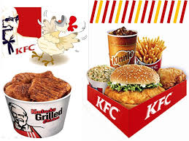
CASE STUDY 1 KFC Introduces Eco-friendly Packaging
KFC is now switching from cardboard to recyclable and biodegradable paper wrapping for some of its products.

Slide 11

CASE STUDY 2 McDonalds
Recently they ran a little piece on packaging which lays out McDonald’s environmental policies in that regard

Slide 12
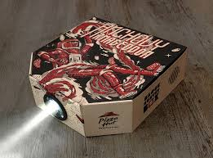
CASE STUDY 3 Pizza Hut Gets a Makeovers
Pizza Hut has a more environmentally – friendly image because they are using new boxes that are made from 40 percent recycled materials.

Slide 13
CONCLUSION
It can be concluded that packaging plays an important role both in promoting the product or service and for the environmental conditions also. So it is very important to choose the correct packaging.

